Slide 1

Sales Data Analysis Report

Slide 2

Key Performance Indicators are the most important metrics in your business. These are numbers that you must regularly monitor so you can determine if your business is on the right track.

Slide 3
Year-over-year (YOY) is the comparison of one period with the same period from the previous year(s).

Slide 4
Gross profit margin is a metric analysts use to assess a company's financial health by calculating the amount of money left over from product sales after subtracting the cost of goods sold (COGS).

Slide 5
Actual Sales Vs Target Sales

Slide 6
Cost of goods sold (COGS) refers to the direct costs of producing the goods sold by a company.

Slide 7
Shrinkage is the loss of inventory that can be attributed to factors such as employee theft, shoplifting, administrative error, etc.

Slide 8
Dump is wastage which is been so arrived due to physical or quality damage to a sale-able product.

Slide 9
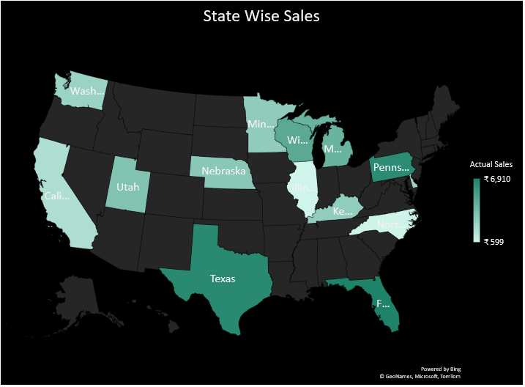
State Wise Sales – Texas, Florida & Pennsylvania has highest sales. State Wise Revenue – California has highest revenue.

Slide 10
Customer Segment & Region Wise Revenue

Slide 11
More sales are happened in Offline stores because of more discounts on offline Stores.

Slide 12
Our Top 5 Employees by sales & our Top 5 Products.

Slide 13
Thank You

